Slide 1
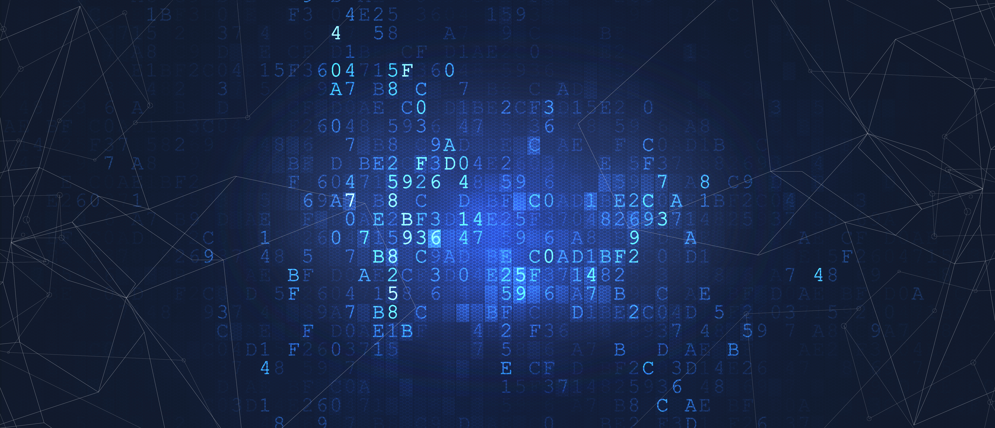
X Seminar Presentation
Learning and Reasoning with Physical, Structural, and Symbolic Priors
Team members: Emma Johnson, Liam Smith, Olivia Brown
Mentors: Noah Davis, Ava Martinez

Slide 2

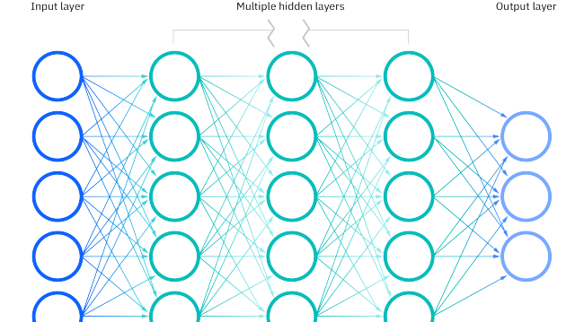



Motivation
Develop generalizable domain-expert models with fewer data
NN
+
Data
General Purpose NN
(Larger model, requiring extensive data)
Domain Knowledge Enhanced NN
(regularized model, requiring less data)
Use cases: climate, traffic, social network, optimizer, etc.

Slide 3
Method | algorithm1 | alg2 | alg3
cssm | 1 | 21 | 3
sspm | 2 | 1 | 2

Slide 4
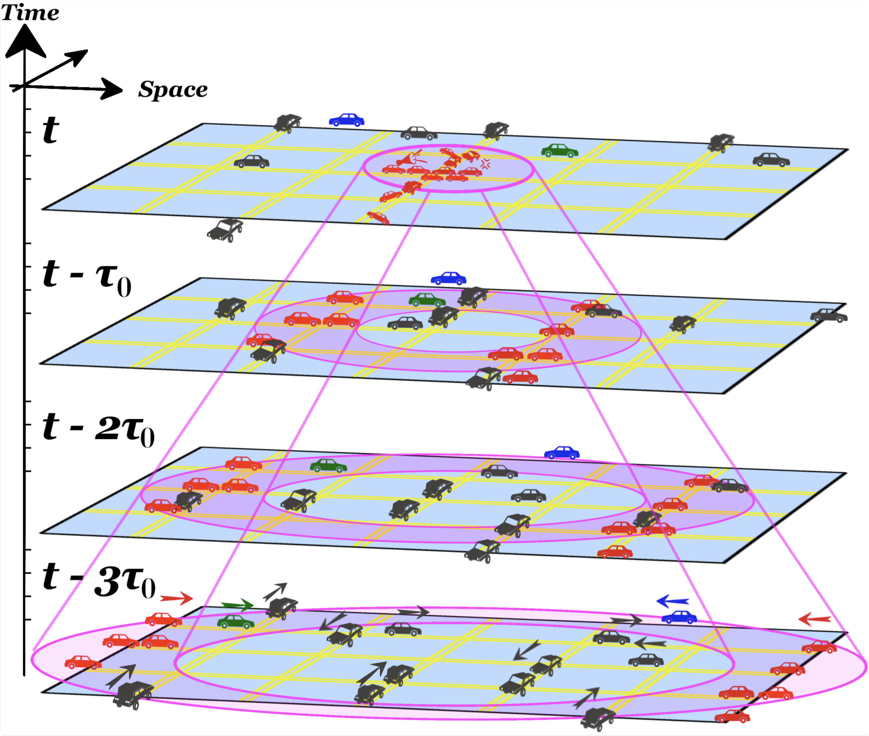
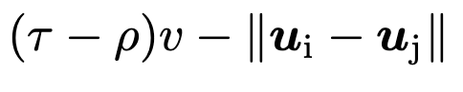
Previously covered in progress review
Learning with Physical Prior
Traffic Light Control
Physical Prior
= 0
Delayed Prop. Transformer (NeurIPS 2021)
(Previously covered in progress review)

Slide 5
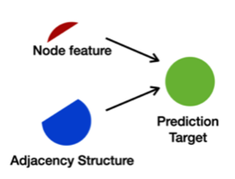
Previously covered in progress review
Learning with Structural Prior
Graph Cold Start Recommendation
Structure Prior
self = Aggregate(self, neighbor)
Method: Knowledge Distillation (ICLR 2022)
(Previously covered in progress review)

Slide 6





Problem Scenario: Program Synthesis
Translate natural language descriptions into python programs
📜
Neural Net
(Transformer)
Problem Description
Please write a program that can …
I/O examples
For example, when input is x, output should be y …
def solution(inputs):
# implementations...
return outputs
How to improve?
- Look at prior structures in codes!
Previous methods: < 20% solve rate for simpler questions, < 5% solve rate for more difficult questions…

Slide 7
reversed_n = list(reversed (n))
AST parsing example
Executable Program
Abstract Syntax Tree
🧑‍💻 Plain String repr
💡 Prior enhanced repr

Slide 8
reversed_n = list(reversed (n))
AST parsing example
Executable Program
Abstract Syntax Tree
🧑‍💻 Plain String repr
💡 Prior enhanced repr

Slide 9
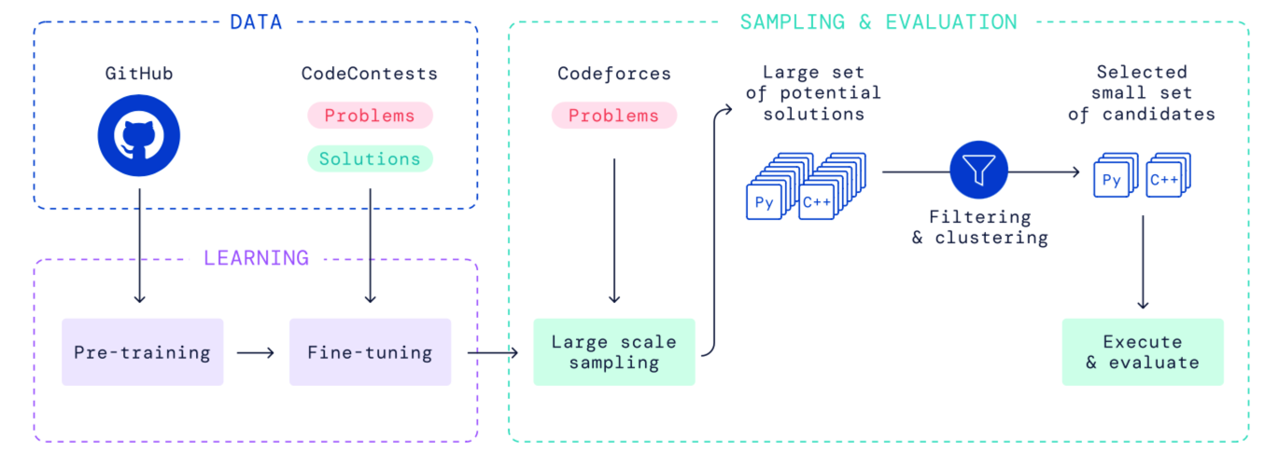

Train And Eval
Follow the pipeline of AlphaCode

Slide 10
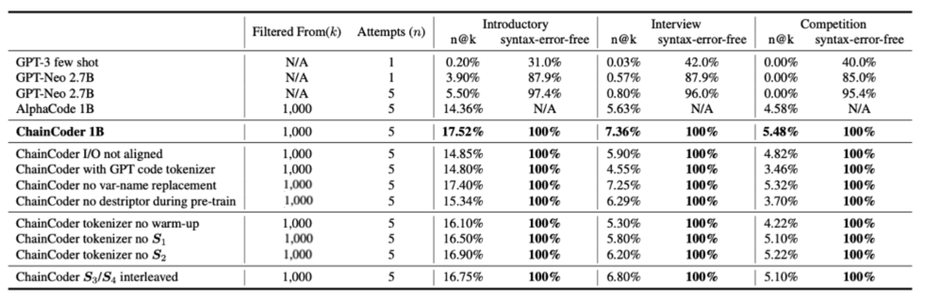
Results
Token occurance frequencies
Comparison With Alphacode
Ablation Studies

Slide 11

Results
Numerical results and ablation studies

